Slide 1
Visual Summary of Implementations
AC299r Fall 2014

Slide 2
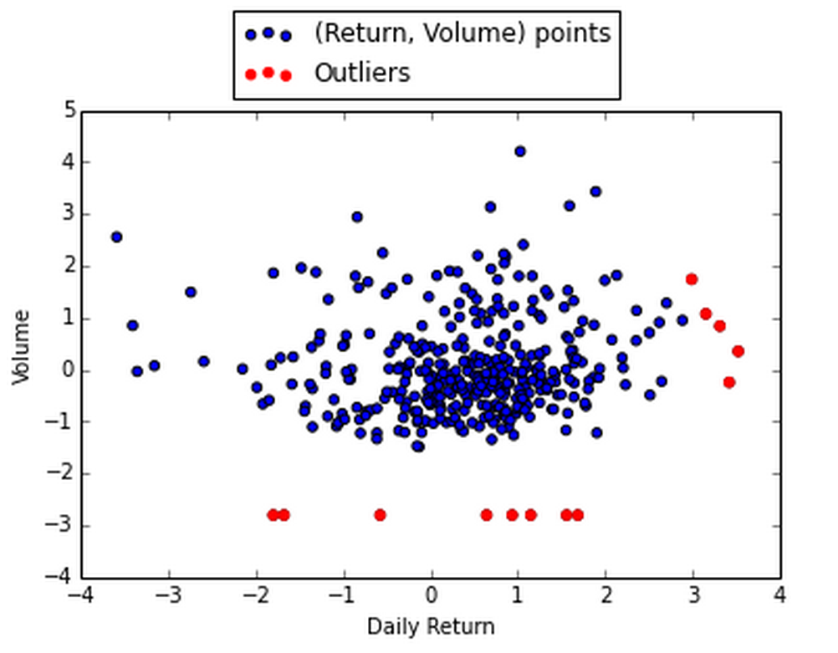
LOCI – Stock
alpha = 0.5
K_sigma =3

Slide 3
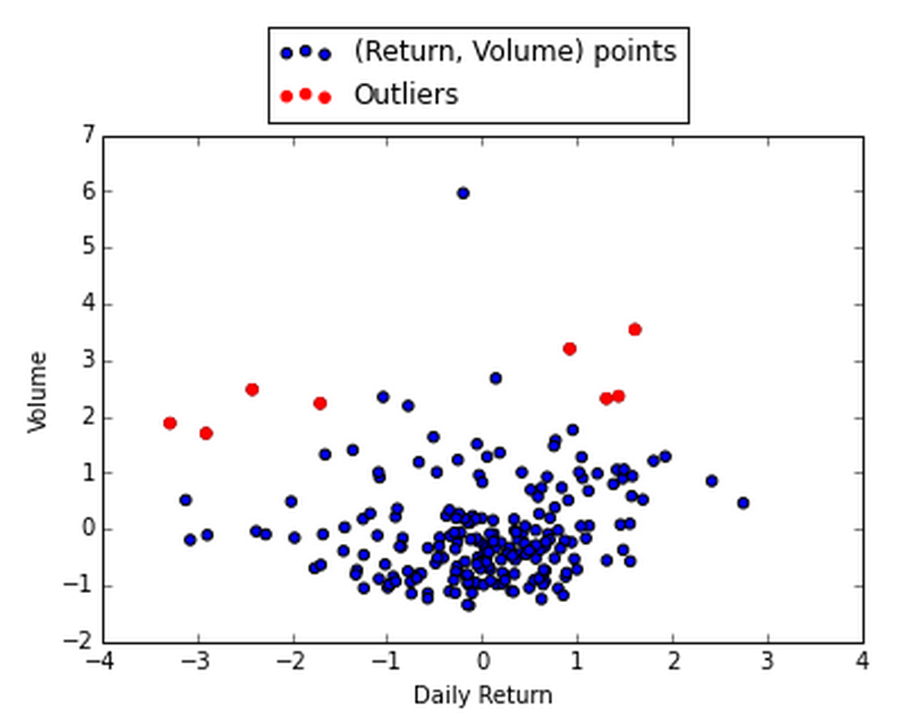
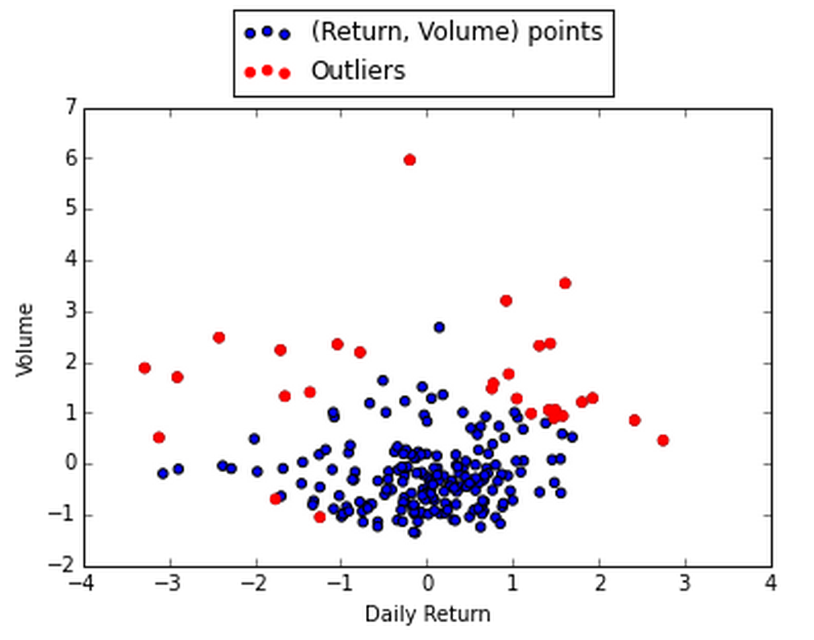
Mixture Model – Normal/Unif, Stock
Thresh = 5.5
Thresh = 4.6

Slide 4
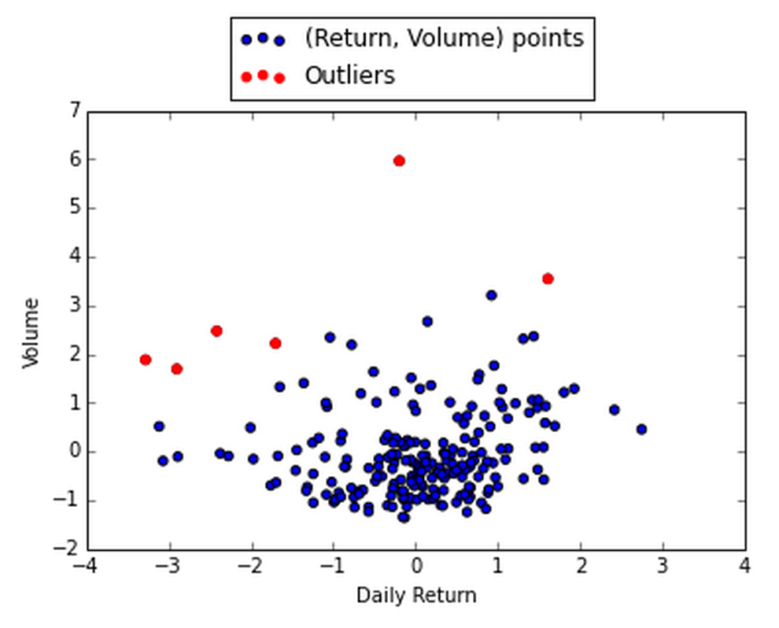
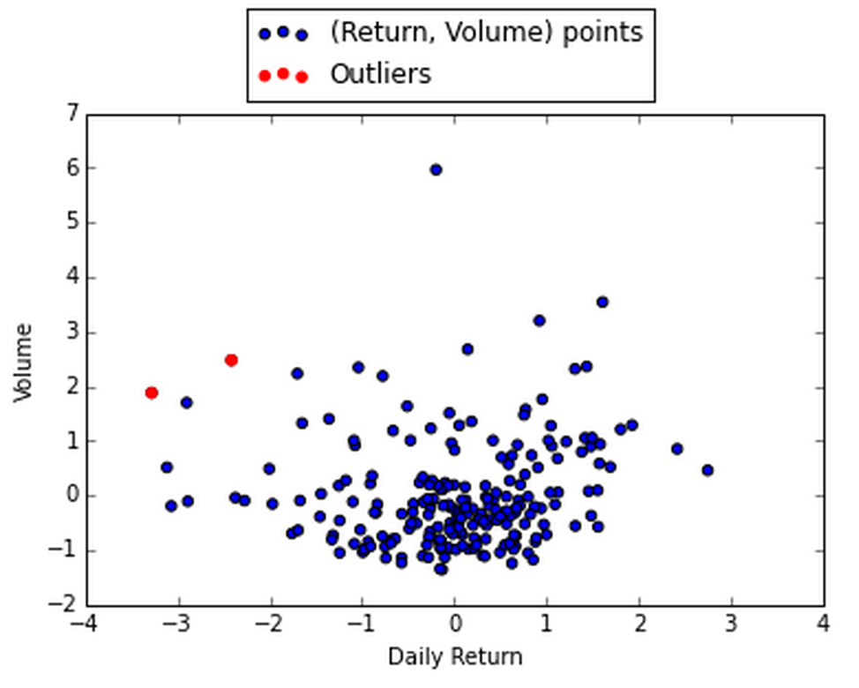
Regression Difference
thresh: 3
thresh: 5

Slide 5
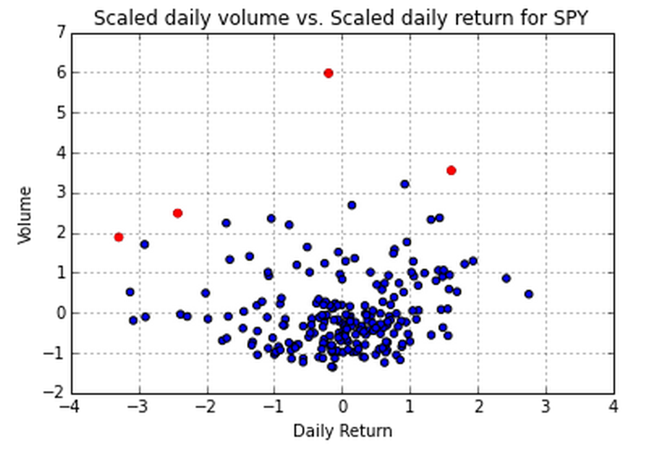
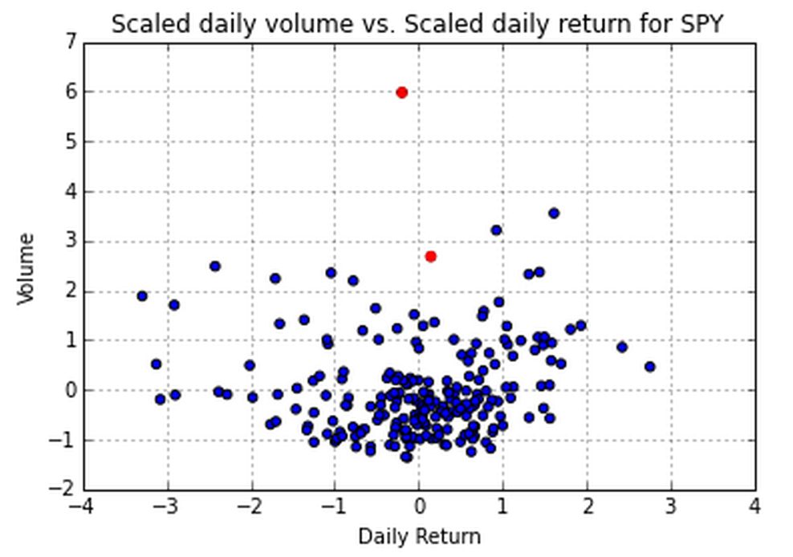
K Nearest Summed Distance
T = 3, R = 0.1
T = 3, R = 0.01

Slide 6
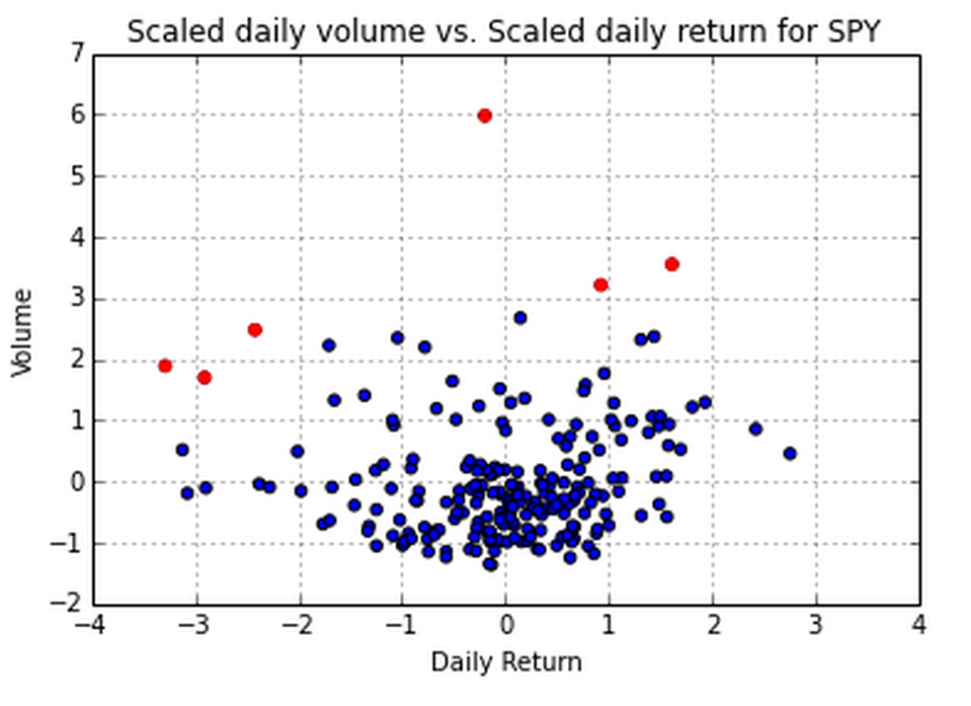
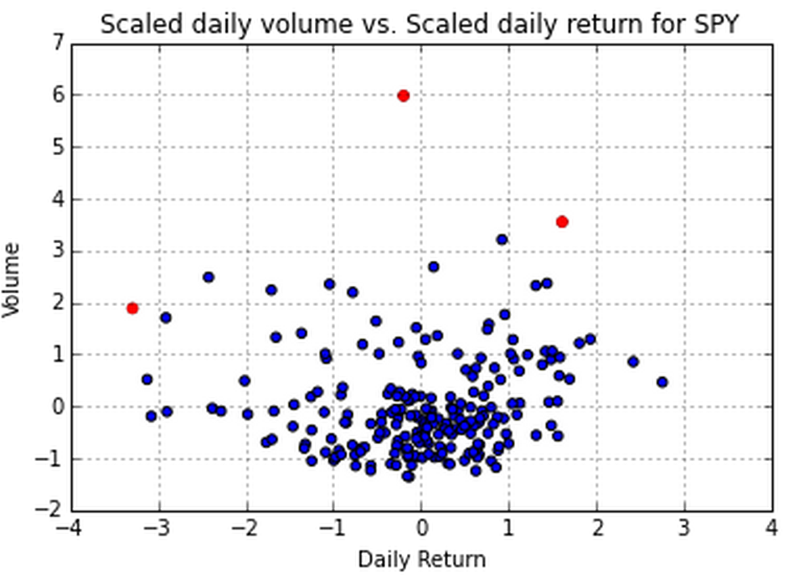
K Nearest Neighbors Count
k = 10, m = 5, d = 1.3
k = 10, m = 5, d = 1.6

Slide 7
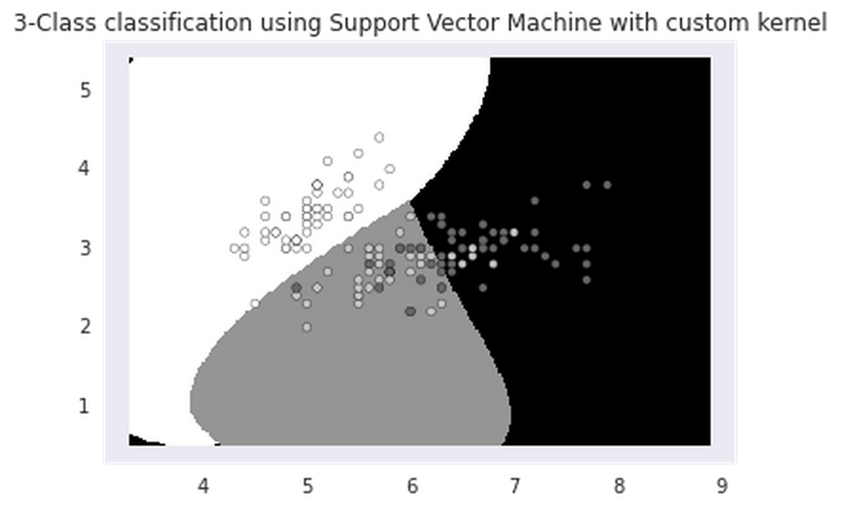
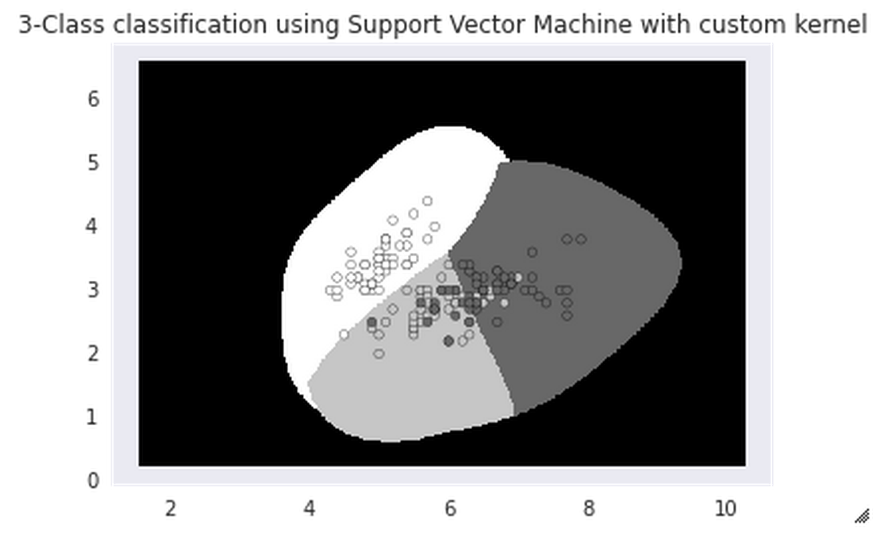
Support Vector Machine - Iris
1 point in outlier class
5 points in outlier class

Slide 8
To Get Code For:
Bayesian Network/Random Forest

